Slide 1
Rock paper scissor comp sci 1 period 3
By Bryant Nguyen and Lajeeth Thangavel

Slide 2
Roles
Bryant
In charge of graphics
Creator of this presentation
Lajeeth
In charge of coding

Slide 3
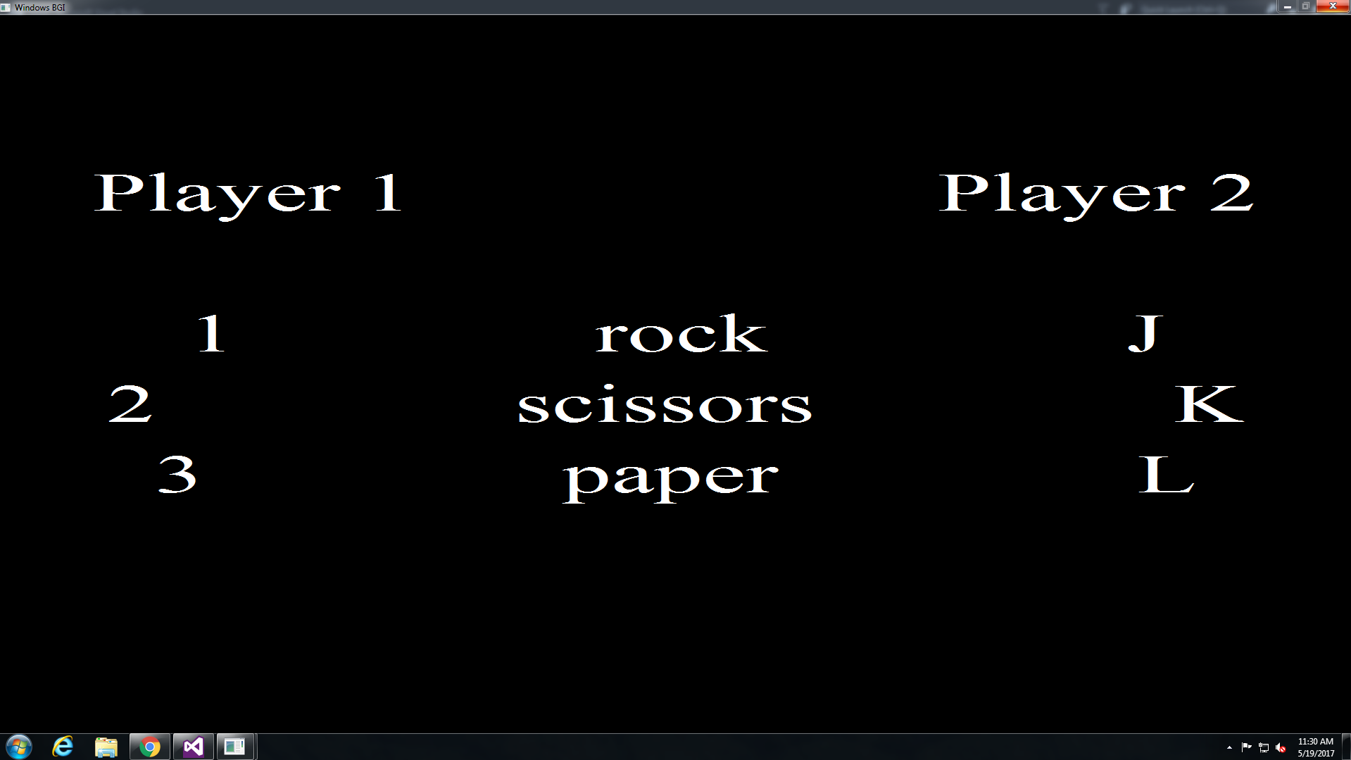
Opening screen

Slide 4
Goals
Short term goals
have an opening screen
Long term goals
have a way to show which player won

Slide 5
How game works
The game works by having two players go against in each with the choice of rock, paper, or scissors. Player 1 has the choice of 1=rock, 2 =paper, or 3=scissors. Then player 2 has the choice of J=rock, K=paper, or L=scissors. Players win with these conditions, rock beats scissors, scissors beats paper, and paper beats rock. When player 1 wins, the background turns green, when player 2 wins, the background turns red, and when it is a draw, the background turns yellow.

Slide 6
Difficulties
The victory text does not pop up on the screen like it should, however, the main menu appears to show up fine.
solution: instead of the “victory” text, we decided to change the color of the text for whichever player won or if it is a draw
We also had trouble with the player input
solution: moved press out of structure so it is in public enum
We also had trouble with the if then statements
Solution: we had assistance of colleagues to fine tune our functions
We wanted to have graphics in our game but had difficulties putting the graphics into the game
Solution: we ended up using text as our “graphics”
We also had issues with our functions being under one void function
Solution: we had the idea of putting each function in separate void functions,

Slide 7
fin

